Slide 1
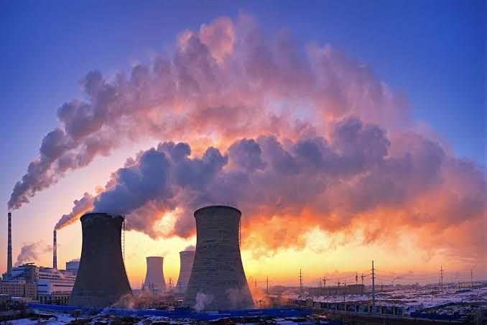
AIR POLUTION
PRESENTED BY :
Mohammed kazim ali qizer
And
mohammed safwan uddin

Slide 2
Content
WHAT IS AIR POLLUTION
TYPES OF POLLUTANTS
SOURCES OF AIR POLLUTION
EFFECTS OF AIR POLLUTION
MEASURES FOR AIR POLLUTION

Slide 3
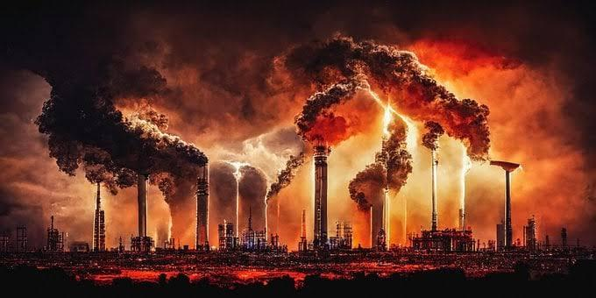
What Is Air Pollution
Air pollution is the contamination of air due to the presence of substance in the atmosphere that are harmful to the health of humans and the other living beings, or cause damage to climate or to materials. It is also the contamination of indoor or outdoor surrounding either by chemical activities, physical or biological agents that alters the natural features of environment or atmosphere

Slide 4
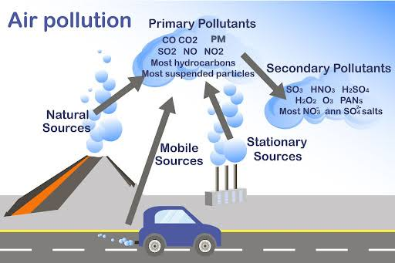
Types Of Pollutants
IN ORDER TO UNDERSRAND THE CAUSES OF AIR POLLUTION, SEVERAL DIVISIONS CAN BE MADE
Primary Air Pollutants can be caused by primary sources or secondary sources. The Pollutant that are direct result of a process can be called primary pollutants.
Secondary Pollutants are the ones that are caused by the inter mingling and reactions of primary pollutants.

Slide 5
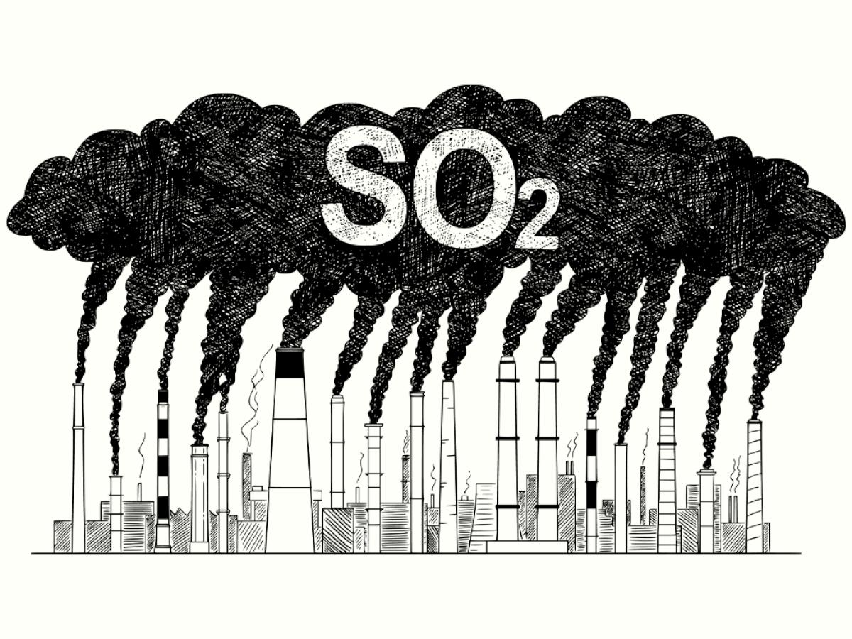
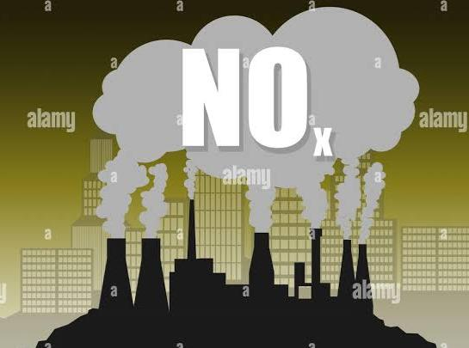
Primary Pollutants
MAJOR PRIMARY POLLUTANTS ARE PRODUCED BY HUMAN Activity.
Sulphur oxides (SO_{x} ) particularly sulphur dioxide, a chemical compound with the formula ( SO₂ )
(SO₂ ) is produced by volcanoes and in varies industrial process. Coal and petroleum often contain sulphur compounds, and their combustion generates sulphur dioxide
Nitrogen oxides (NO_{x} ) particularly nitrogen dioxide, are expelled from high temperature combustion, and are also produced during thunderstorms by electric discharge.
They can be seen as a brown haze dome above or a plume downwind of cities.

Slide 6
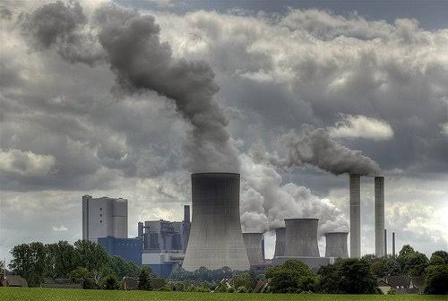
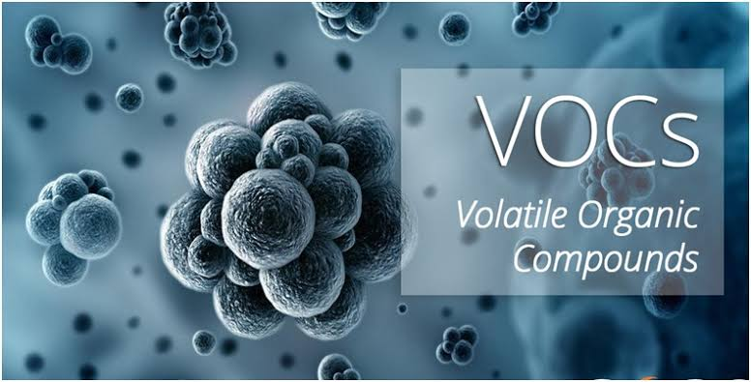
Carbon monoxide ( CO ) Is a colourless, odourless, toxic yet non- irrigation gas.
It is a product of fuel such as natural gas, coal or wood.
Vehicular exhaust is a major source of carbon monoxide.
Volatile organic compounds are well known outdoor air pollutant.
They ar3 categorized as either methane(CH) or non-methane (NMVOCs).
Methane is an extremely efficient greenhouse gas which Contributes to enhance global warming.
The aromatic NMVOCs benzene, toluene and xylene are suspected carcinogens and may lead to leukaemia with prolonged expure

Slide 7
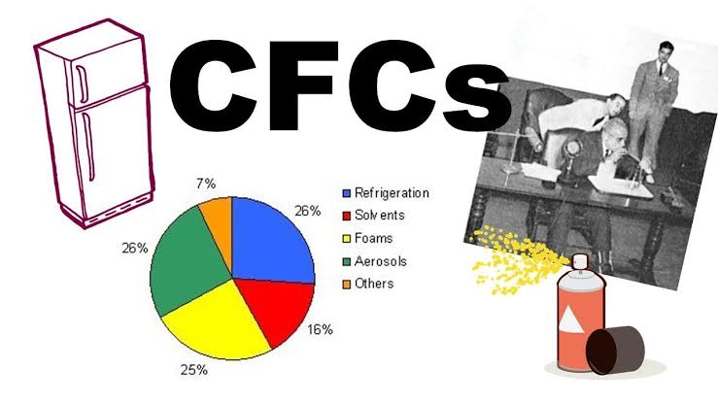
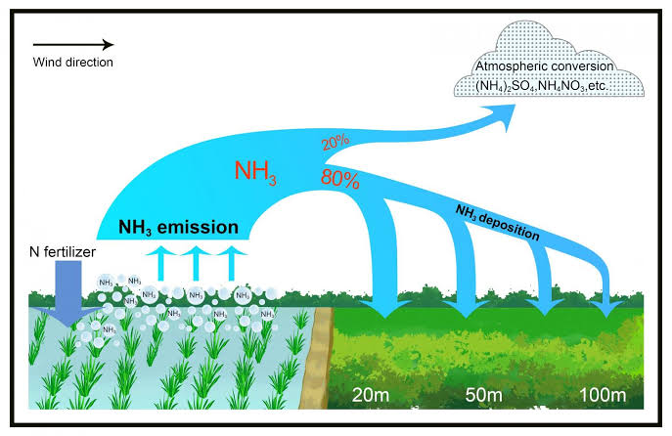
Chlorofluorocarbons (CFCs) harmful to the ozone layer; emitted from products currently banned from use
These are gases which are released from air conditioner, refrigerators, aerosol sprays, etc.
This allows harmful Ultraviolent rays to reach the earth’s surface.
Ammonia (NH₃ ) emitted from agriculture processes.
Ammonia , either directly or indirectly, is also a building block for the synthesis of many pharmaceuticals.
In the atmosphere, ammonia reacts with oxides of nitrogen and sulphur to form secondary particles.

Slide 8
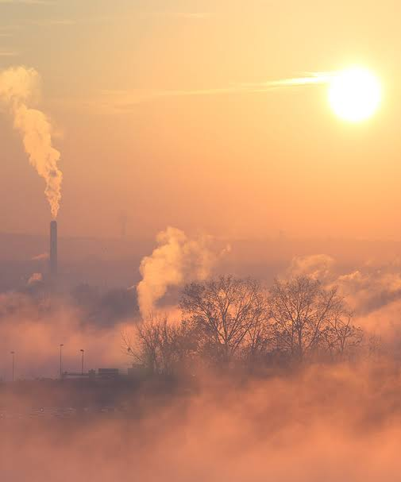
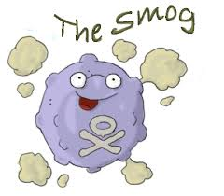
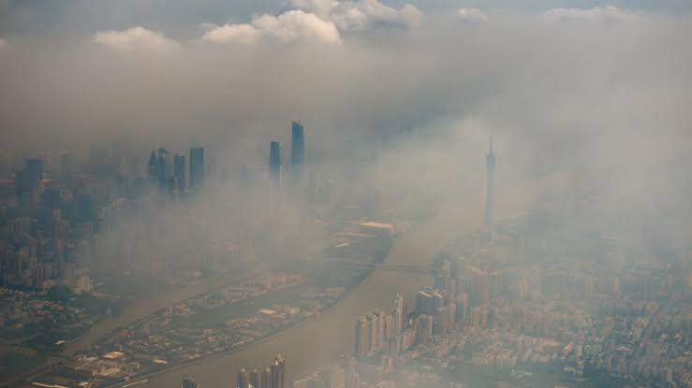
Secondary Pollutants
Particulates created from gaseous of primary pollutants and compounds in photochemical smog.
Smog is a kind of air pollution
Smog results from large amount of coal burning in an area Caused by a mixture of smoke and sulphur dioxide

Slide 9
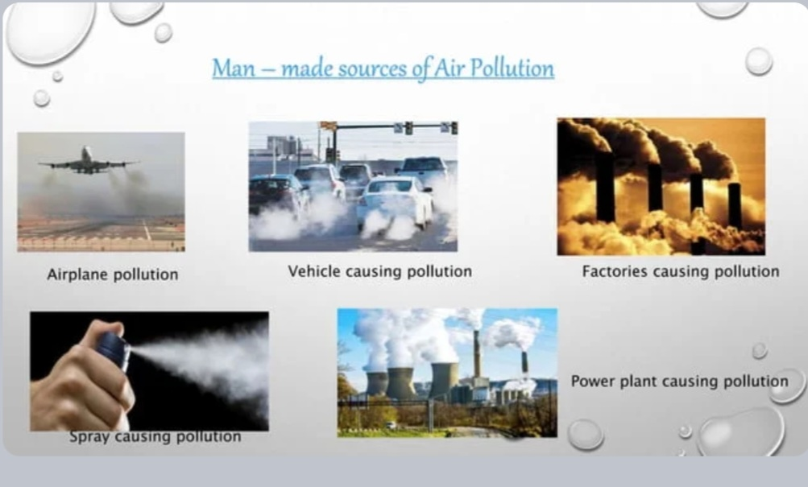
Sources Of Air Pollution
There are various locations, activities or factors which are responsible for releasing pollutants into atmosphere.
These sources can be classified into two major categories
ANTHROPOGENIC (MAN MADE) SOURCES
These are related to the burning of multiple types of fuel.
Chemicals, dust and controlled burn practices in agriculture and forest management.
Mobile sources including motor vehicles, marine vessels and aircrafts.
Fumes from paint, hair spray, varnish, aerosol sprays and other solvents.
Waste deposition in landfills which generate methane.

Slide 10
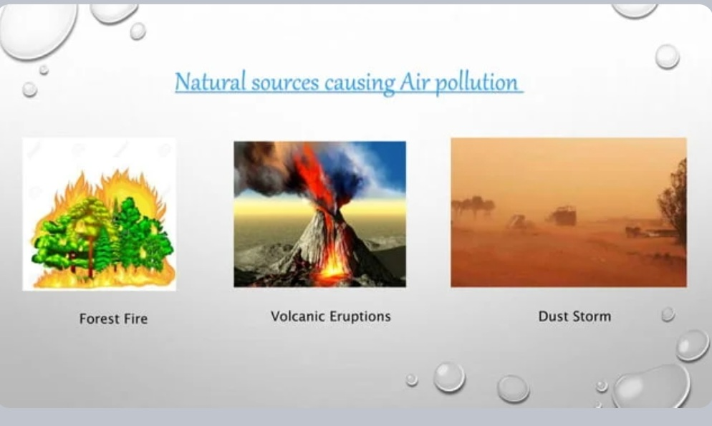
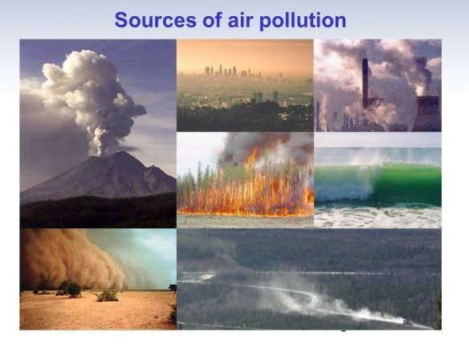
Natural Sources
•Volcanic activity produces sulphur, chlorine and ash particulates in air which causes the air pollution.
•Wildfire produces smoke and harmful gases such as carbon monoxide and carbon dioxide
Burning of Fossil Fuels : sulphur dioxide emitted from the combustion of fossil fuels like coal, petroleum and other factory combustibles of pollution.
All the vehicles emit immense amount of pollution.
Agricultural Activities : Ammonia is a very common by product from agriculture related activities and is one of the most hazardous gases in the atmosphere.
Use of insecticides, pesticides and fertilizers in agricultural activities has grown quite a lot. They emit harmful chemicals into the air and can also cause water pollution.
Mining operators : During the process of mining dust and chemicals are released in the air causing massive air pollution.
Indoor air pollution : Household cleaning products, painting supplies emit toxic chemicals in the air and cause air pollution.

Slide 11
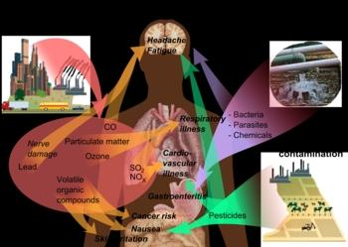
Effects Of Air Pollution
Effects of Air Pollution on Human Health
Air pollution causes following diseases in human body:
Cancer
Asthma
Coughing
Wheezing
Difficulty in breathing
Lung diseases

Slide 12
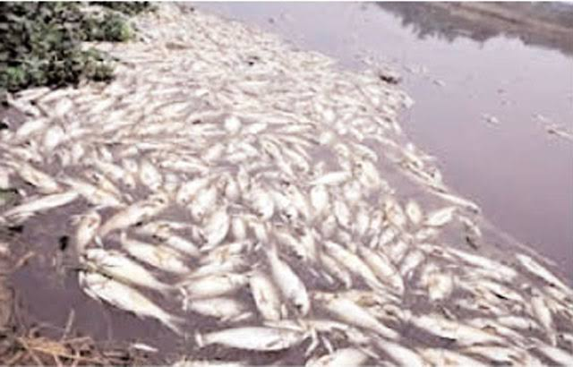
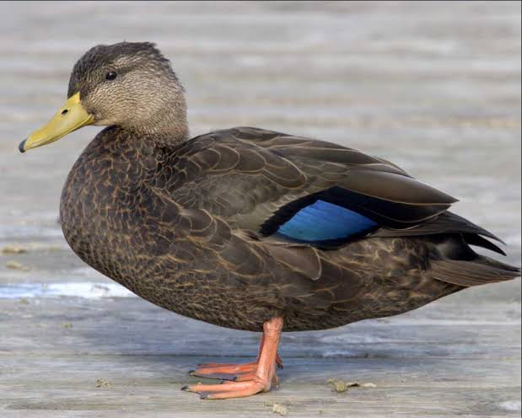
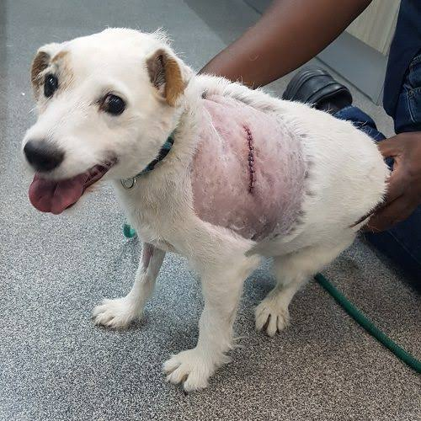
Effects of Air Pollution on Animal Life
Formation of the acid rain in the air damages fish life in lakes and streams.
Rays from ozone layer with excessive ultraviolent radiation coming from the sun may cause skin cancer in animals.
Rays from ozone in the lower atmosphere may Destroy lung tissues of the animals.
Toxic chemicals can force wildlife species to migrate to new places and change their habitant.

Slide 13
Measures For Air Pollution
Use public mode of transportation : Encourage public to use more and more public modes of transportation to reduce pollution.
Conserve energy : Large amount of fossil fuels are burnt to produce electricity. We can save the environment from degradation by reducing the amount of fossil fuels to be burned.
Implementing the concept of Reduce, Reuse and Recycle : Reusing the items which are of no use for some other purposes.
• And Recycling the non decomposable products to protect the environment.
• Reducing the usage of non decomposable products for example plastic.

Slide 14


